Slide 1
WEEK 24
Bimanual neural policy for grasp, handoff, and throw
Cesar A. Pascal Vasquez
Week 24 | 1
Notes:
[Sources]
- /Users/cesarpascal/Documents/Training/week 24 research/README.md
- /Users/cesarpascal/Documents/Training/week 24 research/results/training_summary.json
[/Sources]

Slide 2
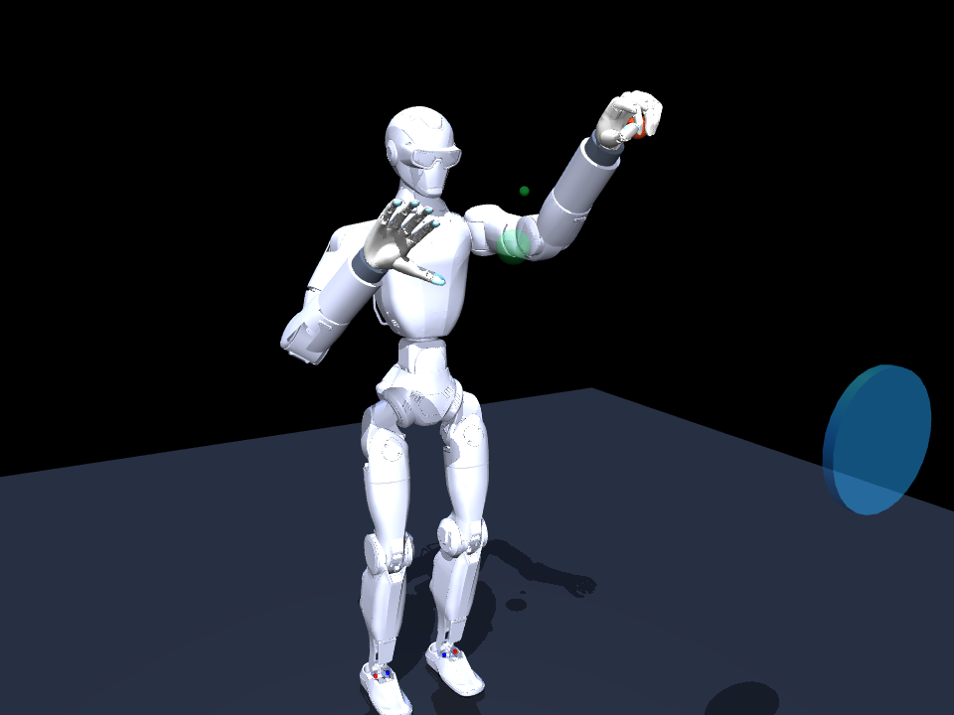
Both R1 wrists now use BrainCo Revo 2 Basic hands.
The stock terminal-hand geometry was removed on both arms. Genuine left- and right-hand Revo 2 XML/STL models are mounted with approximate wrist adapters.
The policy controls 22 actuators at 40 Hz: 10 arm joints and 12 hand joints.
Dual Revo 2 model in MuJoCo
Week 24 | 2
Notes:
[Sources]
- /Users/cesarpascal/Documents/Training/week 24 research/model/r1_revo2_bimanual.xml
- /Users/cesarpascal/Documents/Training/week 24 research/scripts/build_model.py
- https://www.brainco-hz.com/docs/revolimb-hand-dev/en/revo2/parameters.html
- https://www.unitree.com/mobile/R1/
[/Sources]

Slide 3
The policy coordinates four bimanual task stages.
1
Right hand reaches and grasps the ball (0.00–2.48 s).
2
Right arm transports while the left hand approaches (2.48–3.82 s).
3
Left hand closes; the right hand releases (3.62–4.58 s).
4
Left arm lifts, winds up, and throws (4.58–6.06 s).
7.10-s episode | 40 Hz control | nine phase labels
Week 24 | 3
Notes:
[Sources]
- /Users/cesarpascal/Documents/Training/week 24 research/scripts/bimanual_env.py
[/Sources]

Slide 4
Each step uses 94 normalized observations.
TASK (22)
MEMORY (22)
Time + phase: 10
Ball-to-hands: 6
Handoff + target errors: 6
Previous 22 commands
reveal delay and
action history
ROBOT STATE (50)
Palm + ball motion: 15
Arm positions + velocities: 20
Hand ratios: 12
Contacts + fixture: 3
22 TASK + 50 ROBOT + 22 MEMORY = 94 OBSERVATIONS
Week 24 | 4
Notes:
[Sources]
- /Users/cesarpascal/Documents/Training/week 24 research/scripts/bimanual_env.py
[/Sources]

Slide 5
The neural network predicts 22 residual corrections.
INPUT
RESIDUAL
94 normalized observations
Mean/std from teacher data
Clipped noisy state
Arm correction: ±0.24
Hand correction: ±0.10
Final command clipped
–1 to +1
MLP
160 tanh units
160 tanh units
22 tanh outputs
44,502 parameters
SAFE REFERENCE + SCALED NETWORK OUTPUT → 22 COMMANDS
Week 24 | 5
Notes:
[Sources]
- /Users/cesarpascal/Documents/Training/week 24 research/scripts/bimanual_policy.py
- /Users/cesarpascal/Documents/Training/week 24 research/results/training_summary.json
[/Sources]

Slide 6
The learned controller corrects a safe bimanual reference.
Scripted inverse-kinematics waypoints supply the reach, handoff, lift, windup, and throw. The MLP adjusts all four limb groups at every control step.
A contact-gated soft carrier stabilizes the approximate grasp and handoff; it is disabled before release so the ball completes free flight.
The receiving hand closes before the right hand releases
Week 24 | 6
Notes:
[Sources]
- /Users/cesarpascal/Documents/Training/week 24 research/scripts/bimanual_env.py
- /Users/cesarpascal/Documents/Training/week 24 research/scripts/bimanual_policy.py
- https://mujoco.readthedocs.io/en/stable/XMLreference.html
[/Sources]

Slide 7
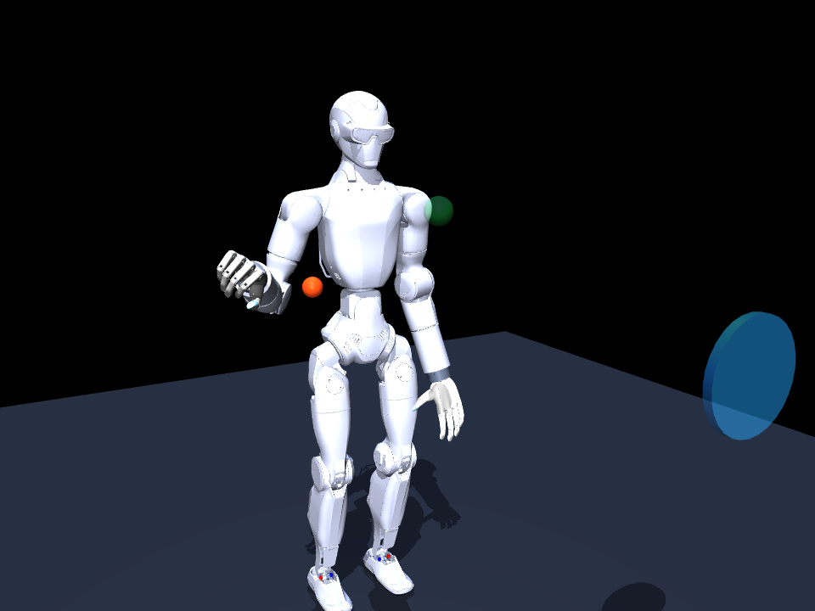
Before training, random residuals miss the first grasp.
0%
complete task success
59.8 mm
minimum reach error
no contact | no grasp | no handoff
ball drops at 2.83 s
Week 24 | 7
Notes:
[Sources]
- /Users/cesarpascal/Documents/Training/week 24 research/results/untrained_demo_metrics.json
- /Users/cesarpascal/Documents/Training/week 24 research/media/untrained_bimanual_handoff_throw.mp4
[/Sources]

Slide 8
The teacher is scripted, not learned.
1
Read the randomized ball, handoff, and target positions.
2
Solve right reach/transport and left receive/throw waypoints with IK.
3
Interpolate the waypoints and apply timed power grasps.
4
Return the 22 ideal commands used as training labels.
Teacher success: 97.1% over 140 randomized demonstrations
Week 24 | 8
Notes:
[Sources]
- /Users/cesarpascal/Documents/Training/week 24 research/scripts/bimanual_env.py
- /Users/cesarpascal/Documents/Training/week 24 research/results/training_summary.json
[/Sources]

Slide 9
Training combines teacher data with two corrective rounds.
1
Collect 140 teacher episodes beginning at seed 24,000.
2
Store each 94-value state with its 22-value target.
3
Run 3,000 Adam updates: batch 512, learning rate 1.1×10⁻³.
4
Add two DAgger rounds: 40 episodes and 1,500 updates each.
55,926 samples | 6,000 updates | hidden width 160 | nine-phase batches
Week 24 | 9
Notes:
[Sources]
- /Users/cesarpascal/Documents/Training/week 24 research/scripts/train_policy.py
- /Users/cesarpascal/Documents/Training/week 24 research/results/training_summary.json
[/Sources]

Slide 10
Behavioral cloning fits the teacher’s residual targets.
TARGET
EMPHASIS
Teacher action
minus safe reference
scaled and clipped
Arm outputs: 4.0
Hand outputs: 1.6
Gradients clipped:
–2 to +2
OBJECTIVE
Weighted mean-square error
Adam, batch 512
LR 1.1×10⁻³
weight decay 10⁻⁶
TEACHER TARGETS → WEIGHTED ERROR → UPDATED MLP
Week 24 | 10
Notes:
[Sources]
- /Users/cesarpascal/Documents/Training/week 24 research/scripts/train_policy.py
- /Users/cesarpascal/Documents/Training/week 24 research/scripts/bimanual_policy.py
- https://arxiv.org/abs/1412.6980
[/Sources]

Slide 11
DAgger teaches recovery from the policy’s own states.
1
Run 40 mixed teacher/network episodes.
2
Ask the teacher to label every state the mixture visits.
3
Append the new states and labels, keeping all earlier data.
4
Retrain 1,500 updates at 8.25×10⁻⁴, then repeat.
Teacher execution probability falls from 45% to 18%
Week 24 | 11
Notes:
[Sources]
- /Users/cesarpascal/Documents/Training/week 24 research/scripts/train_policy.py
- https://proceedings.mlr.press/v15/ross11a.html
[/Sources]

Slide 12
Domain randomization makes the simulated policy more robust.
• Geometry: randomized ball start, handoff, target, and IK seeds.
• Ball: radius 16.8–19.2 mm, mass 40–65 g, friction 0.85–1.35.
• Robot: actuator gains 84–116% and command delay of 0–2 frames.
• Sensing: Gaussian observation noise, σ = 0.009.
Every final result comes from 100 unseen randomized evaluation episodes.
Week 24 | 12
Notes:
[Sources]
- /Users/cesarpascal/Documents/Training/week 24 research/scripts/bimanual_env.py
- /Users/cesarpascal/Documents/Training/week 24 research/results/final_policy_evaluation.json
[/Sources]

Slide 13
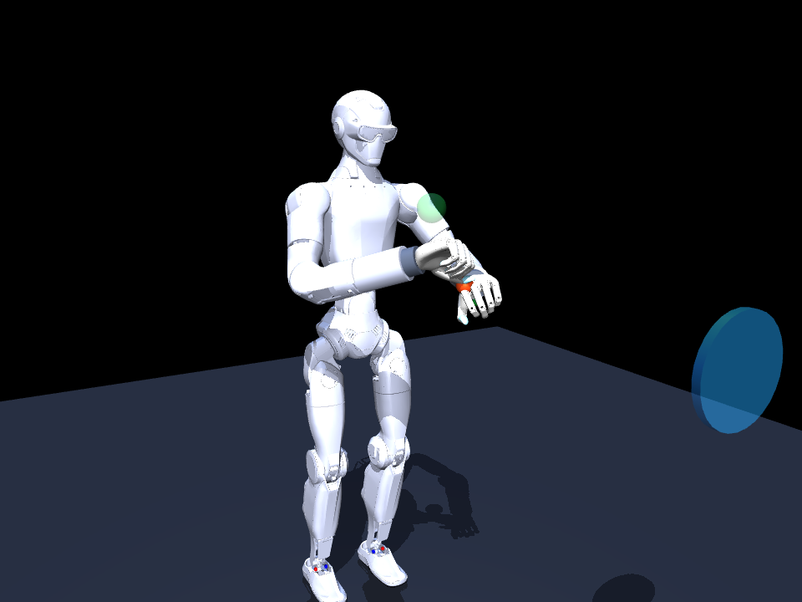
After training, the policy completes the handoff and throw.
86%
complete task success
10.6 mm
mean minimum reach error
91% right grasp | 89% left transfer
0.20 m mean throw
Week 24 | 13
Notes:
[Sources]
- /Users/cesarpascal/Documents/Training/week 24 research/results/final_policy_evaluation.json
- /Users/cesarpascal/Documents/Training/week 24 research/results/trained_demo_metrics.json
- /Users/cesarpascal/Documents/Training/week 24 research/media/trained_bimanual_handoff_throw.mp4
[/Sources]

Slide 14
The simulation is successful, with clear next steps.
Across 100 unseen episodes, the full sequence succeeds 86%; transfer and left-hand hold succeed 89%; mean peak forward speed is 1.36 m/s.
Next: calibrate the wrist adapters and collision meshes, validate hardware limits and latency, then test reducing the grasp stabilizer.
Free-ball release after the left-hand windup
Week 24 | 14
Notes:
[Sources]
- /Users/cesarpascal/Documents/Training/week 24 research/results/final_policy_evaluation.json
- /Users/cesarpascal/Documents/Training/week 24 research/README.md
- /Users/cesarpascal/Documents/Training/week 24 research/media/trained_throw.png
[/Sources]

Slide 15
References
BrainCo Hand. (n.d.). Revo 2 product parameters. https://www.brainco-hz.com/docs/revolimb-hand-dev/en/revo2/parameters.html
BrainCo Hand. (n.d.). Revo 2 download center. https://www.brainco-hz.com/docs/revolimb-hand-dev/en/revo2/download.html
DeepMind. (n.d.). MuJoCo XML reference. https://mujoco.readthedocs.io/en/stable/XMLreference.html
Kingma, D. P., & Ba, J. (2015). Adam: A method for stochastic optimization. International Conference on Learning Representations. https://arxiv.org/abs/1412.6980
Ross, S., Gordon, G. J., & Bagnell, J. A. (2011). A reduction of imitation learning and structured prediction to no-regret online learning. Proceedings of AISTATS, 15, 627–635. https://proceedings.mlr.press/v15/ross11a.html
Unitree Robotics. (n.d.). R1 humanoid robot. https://www.unitree.com/mobile/R1/
Week 24 | 15
Notes:
[Sources]
- https://www.brainco-hz.com/docs/revolimb-hand-dev/en/revo2/parameters.html
- https://www.brainco-hz.com/docs/revolimb-hand-dev/en/revo2/download.html
- https://mujoco.readthedocs.io/en/stable/XMLreference.html
- https://arxiv.org/abs/1412.6980
- https://proceedings.mlr.press/v15/ross11a.html
- https://www.unitree.com/mobile/R1/
[/Sources]

